Slide 1

HOME AUTOMATION
using GOOGLE FIREBASE AND MIT APP INVENTOR

Slide 2
Thank You
In today’s world with the increasing energy requirement we cannot afford to waste the power and also we cannot compromise on the safety. While people are pursuing ever growing high quality of their lives today.
How to control and manage these versatile facilities and appliances in house while also keeping the safety in mind ???
PROBLEM
STATEMENT

Slide 3
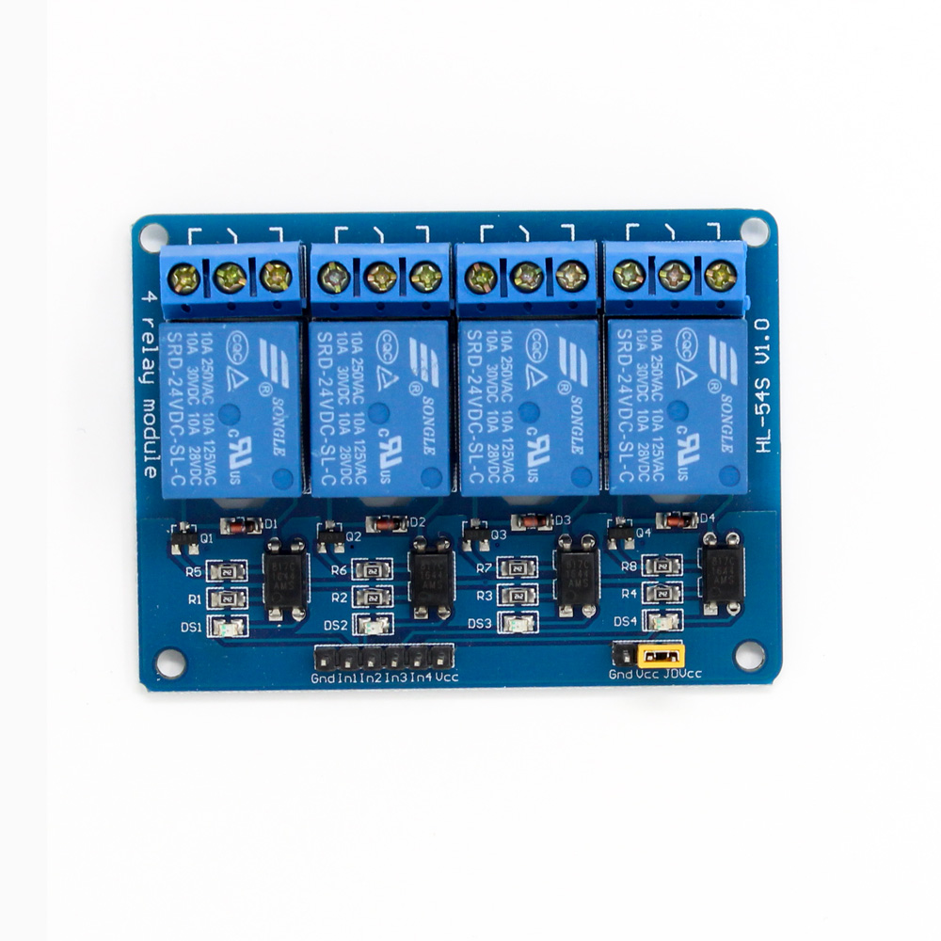

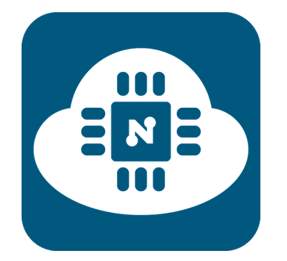
Tech Requirements
NodeMCU
ESP8266
Application working with Firebase
4-Channel
Relay Module

Slide 4
Tech Requirements
A low-cost open source IoT platform.
Specification - NodeMCU V1.0(ESP-12E Module)
Microcontroller : ESP-8266 32-bit
Clock Speed : 80 MHz
USB Converter : CP2102
USB Connector : Micro USB
Operating Voltage : 3.3V
Flash Memory : 4 MB
Digital I/O : 11
Analog Inputs : 1
Communications : Serial, SPI. I2C and 1-Wire via software
Wi-Fi : Built-in 802.11 b/g/n
NodeMCU
ESP8266

Slide 5
Tech Requirements
The Application is made using the MIT App INVENTOR.
A Firebase Project and it’s ID is created and is connected to the application.
Realtime Database works on Firebase as our Application Functions.
Application working with Firebase

Slide 6
Tech Requirements
- Input supply 12 VDC @ 170 mA
- Output four SPDT relay
- Relay specification 5 A @ 230 VAC
- Trigger level 2 ~ 5 VDC
- Berg pins for connecting power and trigger voltage
- LED on each channel indicates relay status
- Power Battery Terminal (PBT) for easy relay output and aux power connection
- Four mounting holes of 3.2 mm each PCB dimensions 88 mm x 68 mm
4 Channel
Relay Module

Slide 7
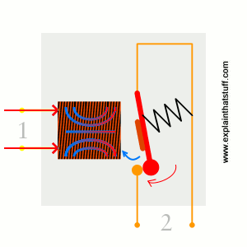
WORKING OF A SIMPLE RELAY

Slide 8
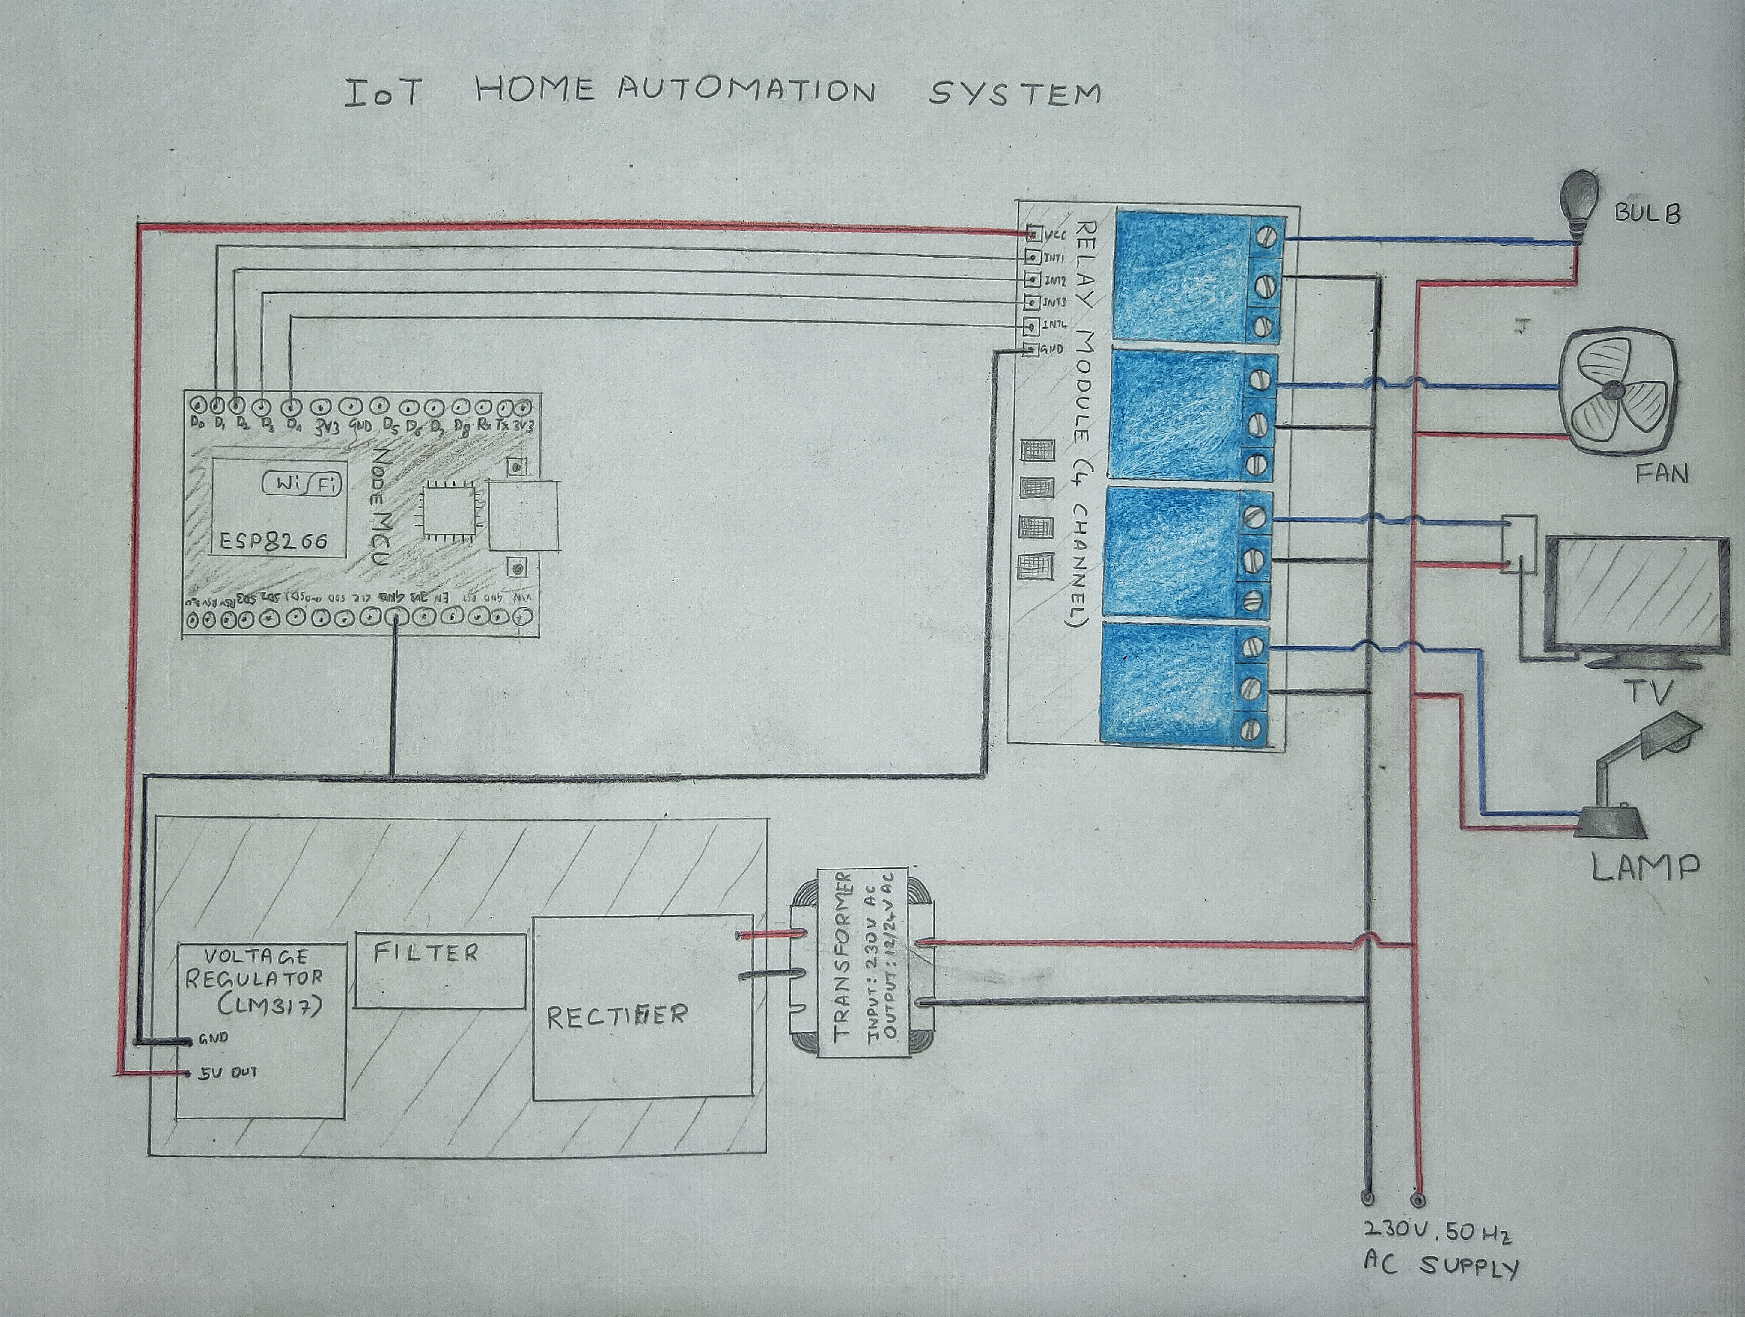
Thank You
circuit
DIAGRAM

Slide 9
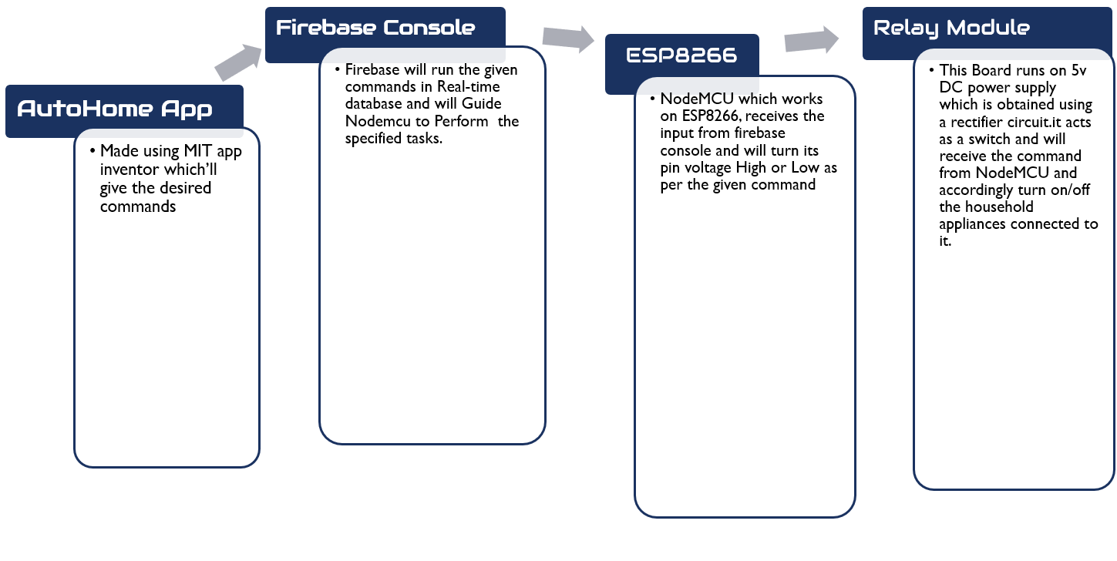

Slide 10
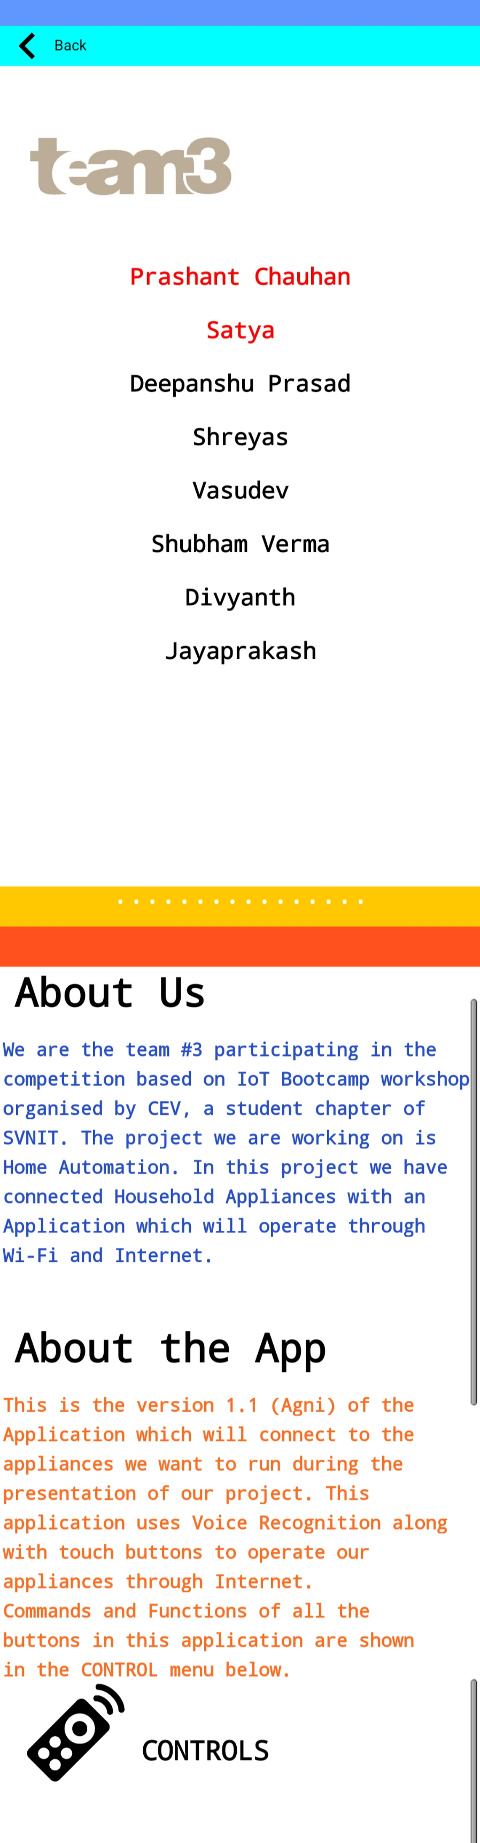

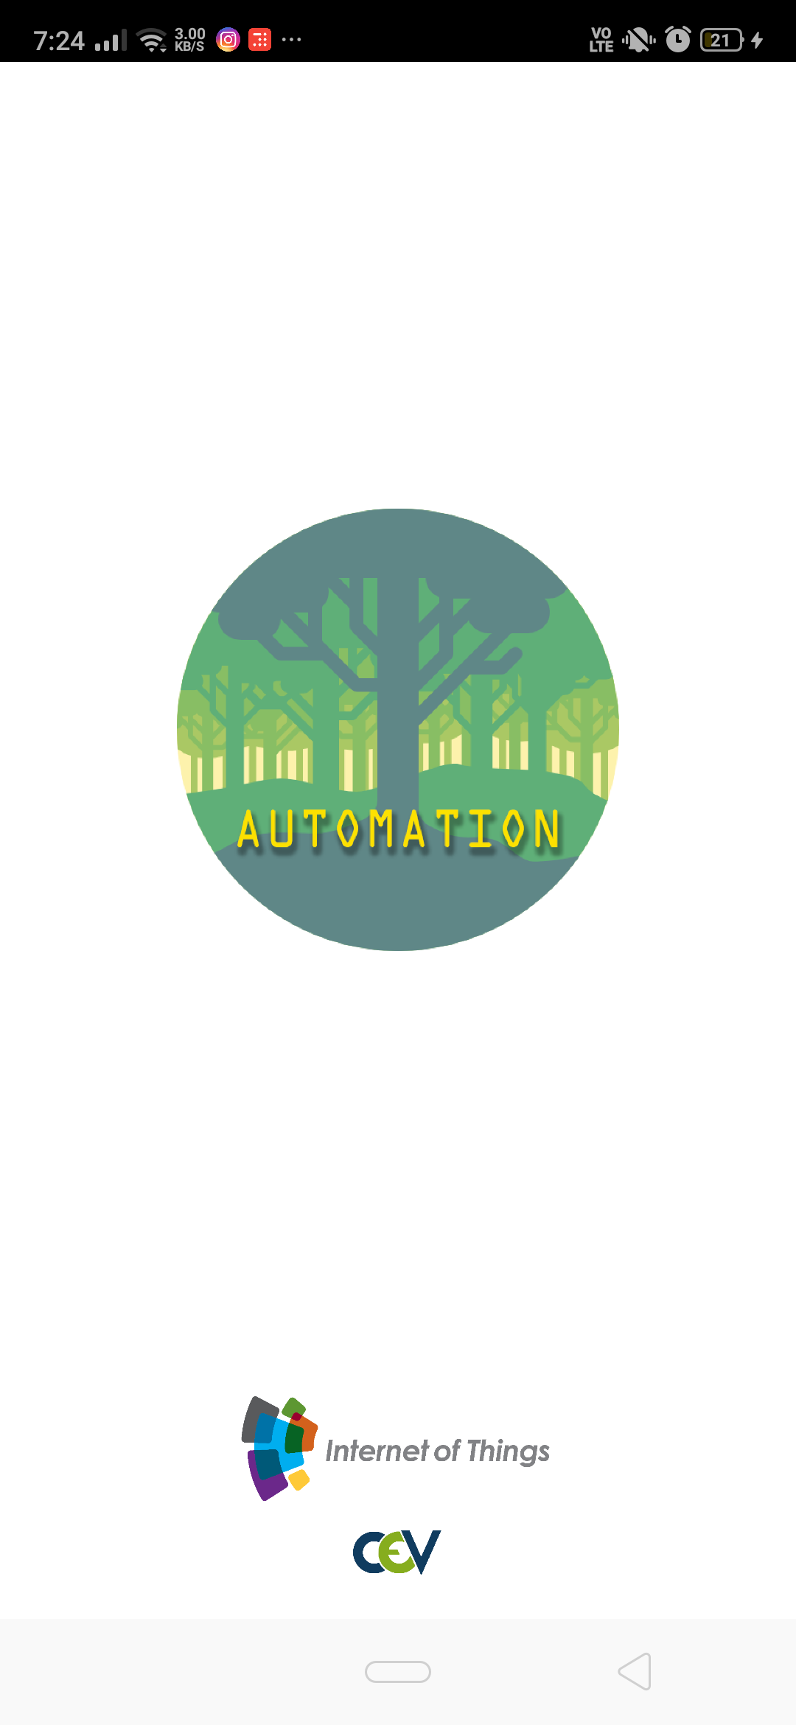
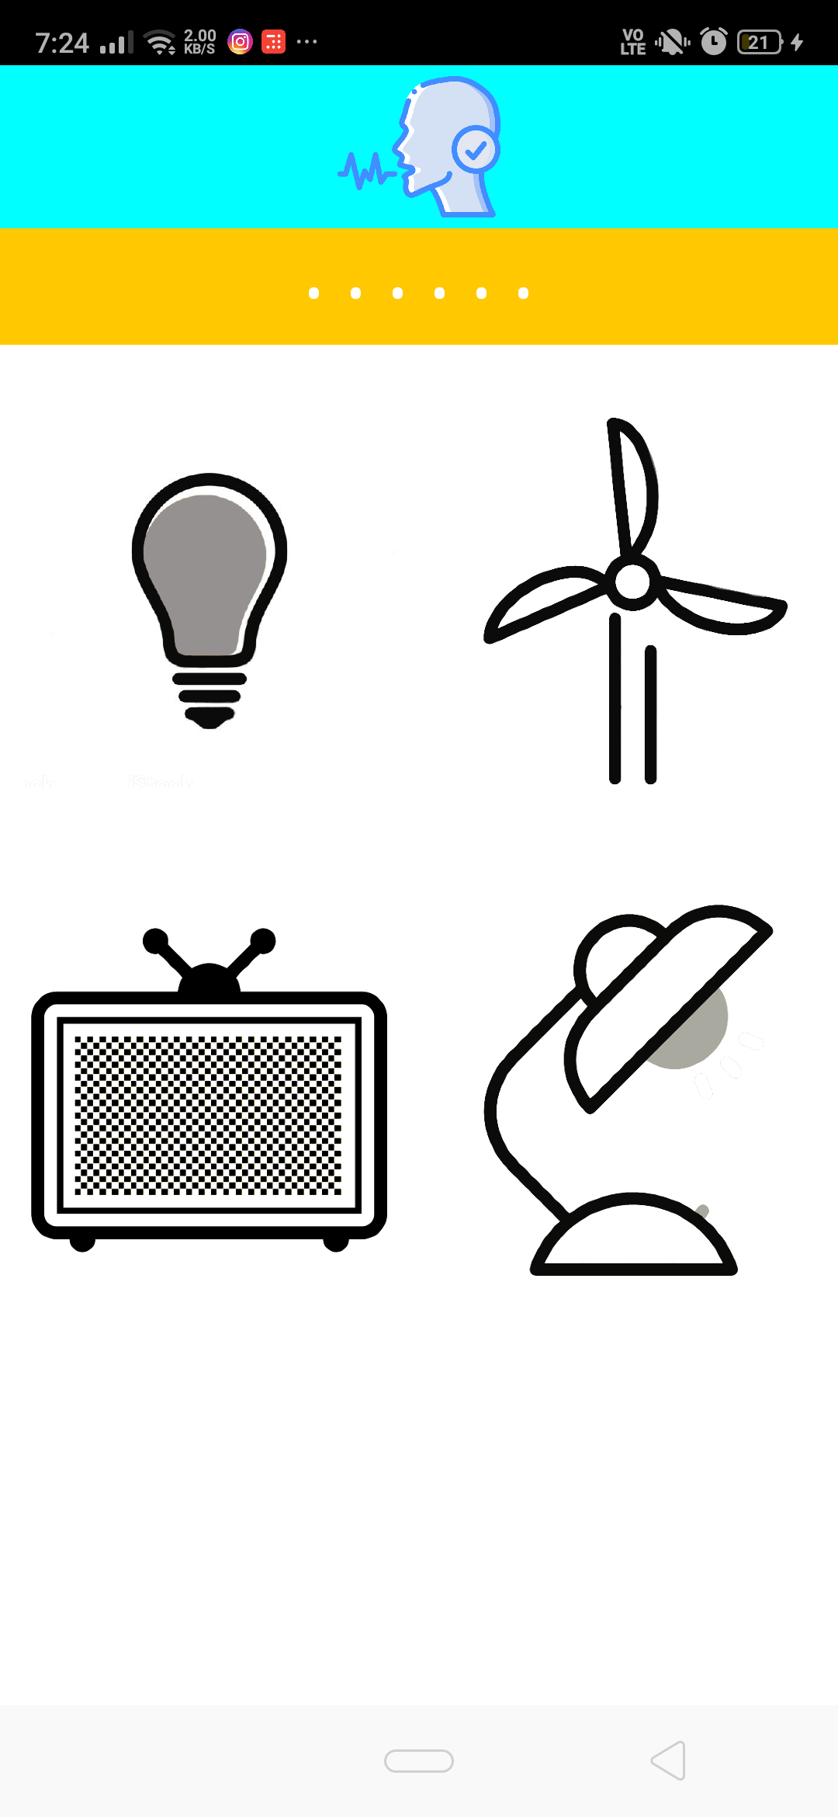
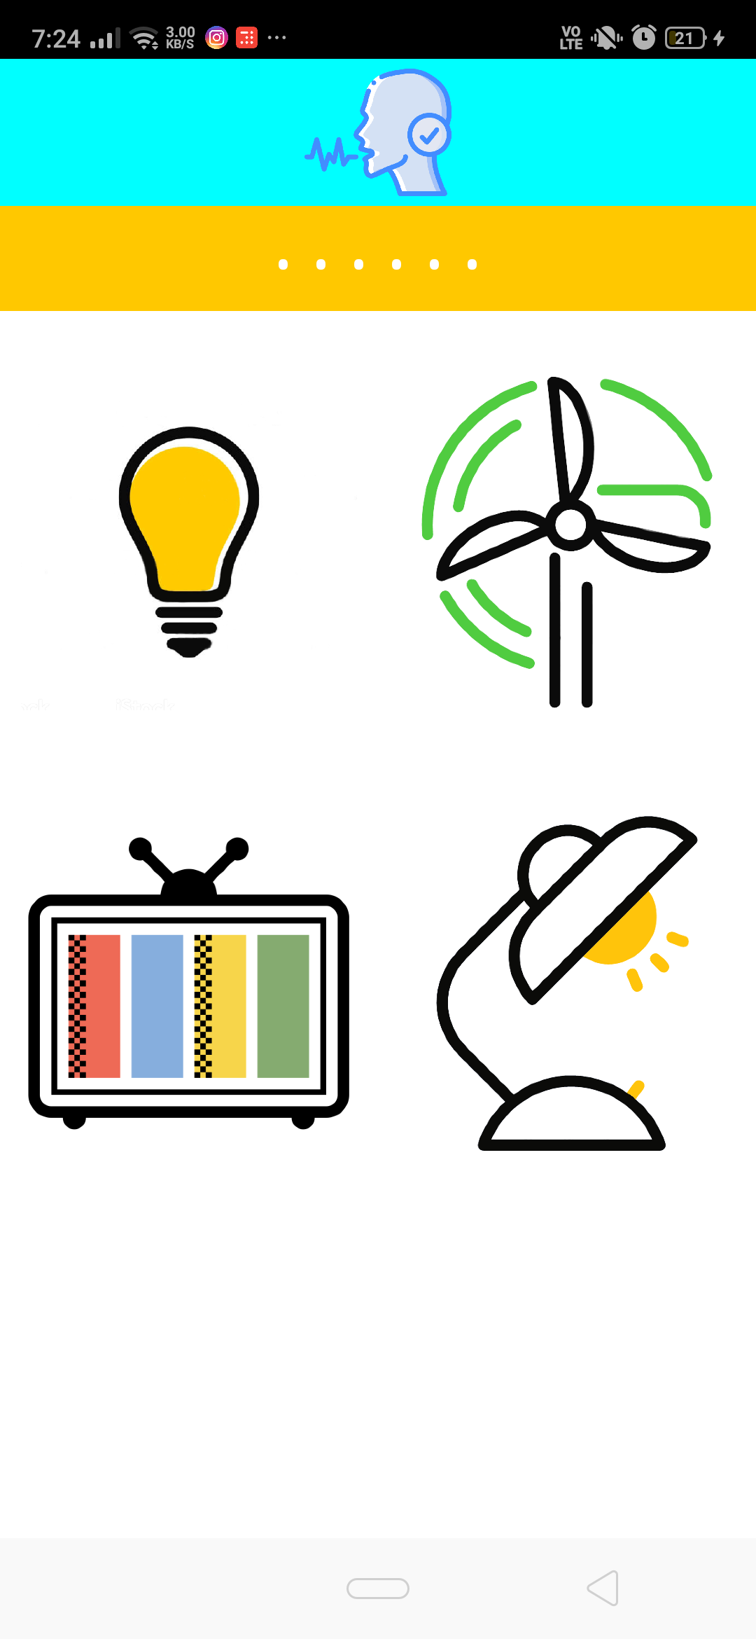
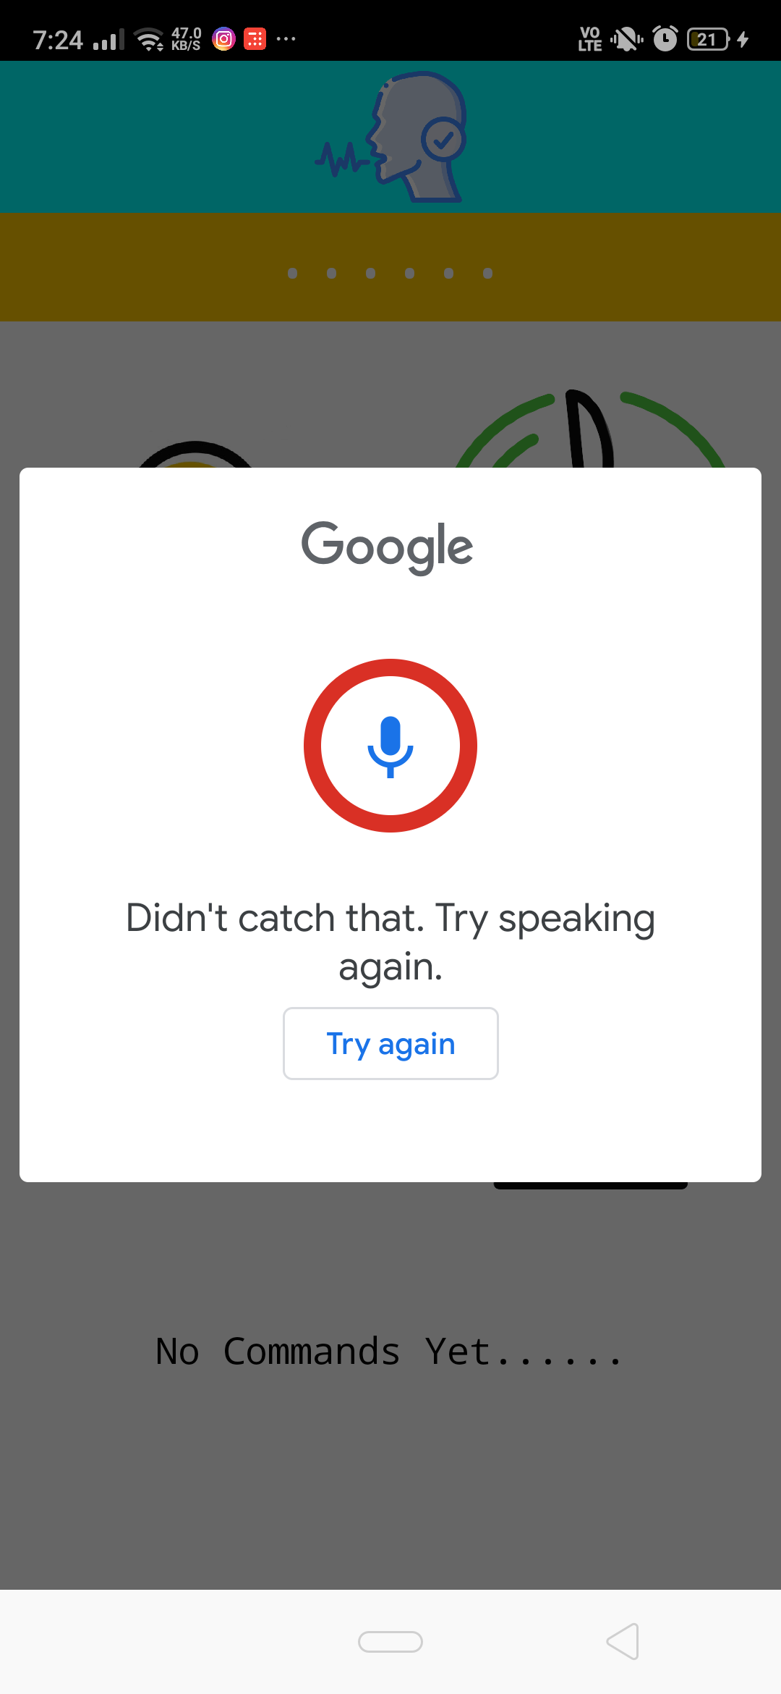
APP ui
TAP
VOICE
RECOGNITION
WELCOME
SCREEN
TAP
SWITCH BUTTONS
LONG PRESS

Slide 11

Challenges we faced
Problems with Arduino IDE, like uploading the Code, installing Libraries, connecting Ports.
Connecting the fail-proof circuit and providing 5V power to Relays through Rectifier.
Meeting and discussing about the progression of project.
Connecting the AutoHome application to NodeMCU through Firebase.
Including a working Voice Recognition System in the application and making it accept different types of commands.

Slide 12
Limitations of our prototype
Home Automation is meant to be running several Home Appliances through the Mobile Application. It must be capable of making a home feel automated. Considering this, our prototype has some limitations.
Since 4-Channel Relay Module is used here, we can only connect four appliances to it.
The Relay acts as a Switch which can only turn on/off the appliance connected, therefore we could not achieve the Voltage variation, which could be used to Change the Brightness of Light or to change the Fan Speed.
We did not use a unique ID for our system, hence anybody having the app can operate as per wish.

Slide 13

Thank You
Team 3
IoT Bootcamp
CEV
SVNIT

